Slide 1
~ Final Project ~
Motion Analysis
Claire Langfoss, Ranit Karmakar, and Jaisil Rose Dennison

Slide 2
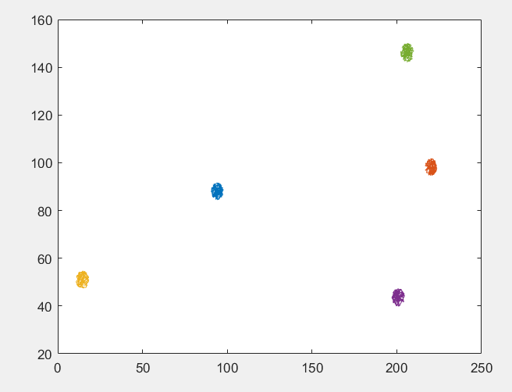
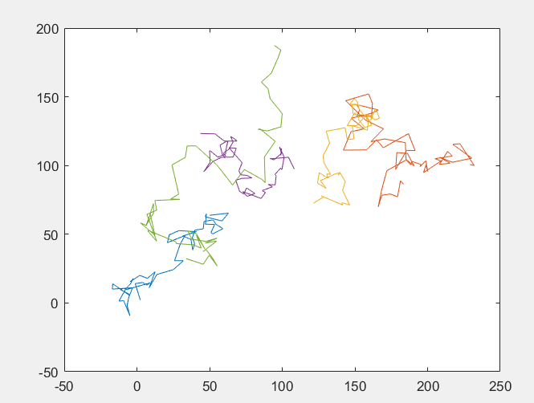
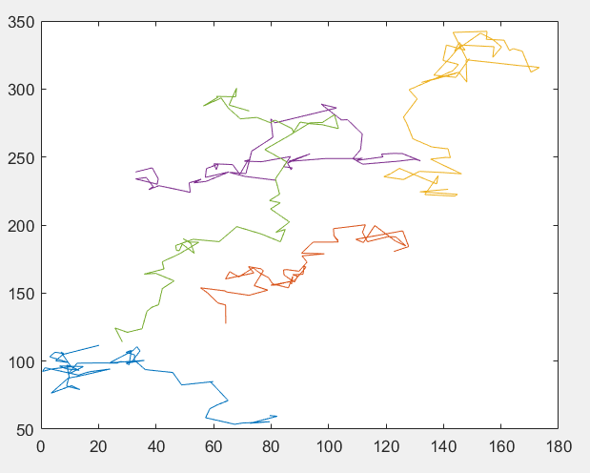
Background
Confinded
A.Confined Motion
B. Free Motion
C. Drift Motion

Slide 3
Background
Goal:
Write a software package which can determine the trajectory motion type of the particles
Apply our motion classifier to supplied trajectory data set
Compare output against ground truth provided
Apply motion classifier to real trajectories and find motion type

Slide 4
Background
Approaches:
Mean Square Displacement Analysis
Anisotropic/Isotropic Analysis
Moment Scaling Displacement

Slide 5
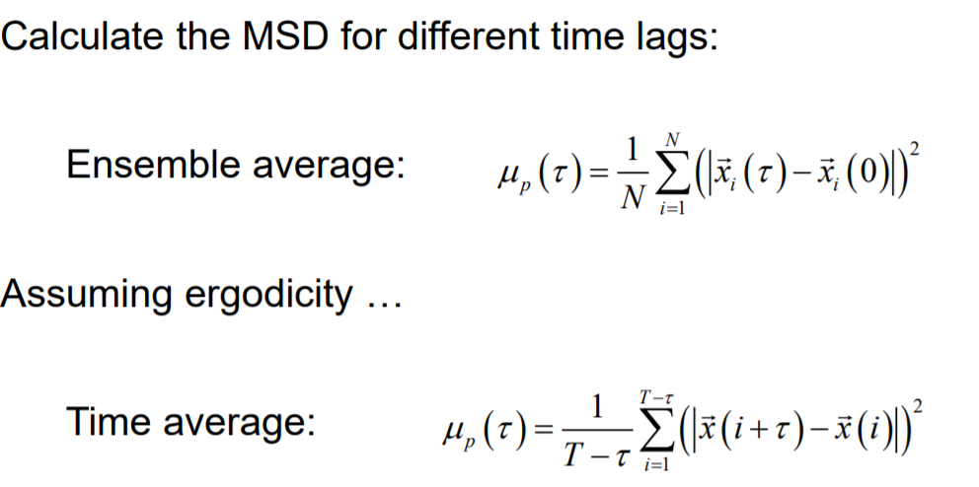
Mean Square Displacement
Features:
Used: simMultiMotionTypeTrajCVMI
Focus: durationRange
Calculating MSD: Mean displacement for particle at each time step ~ 20 of each
Mean of MSD (input into ClassificiationLearner)
Notes:
Finds

Slide 6
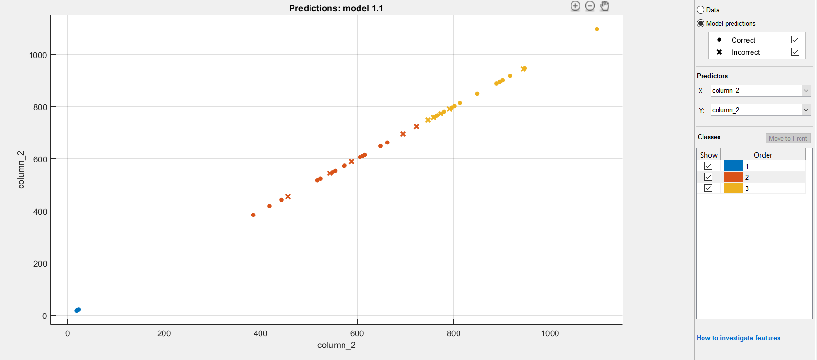
Mean Square Displacement
Using: Linear Discriminant
Mean MSD
Mean MSD
Mean MSD

Slide 7
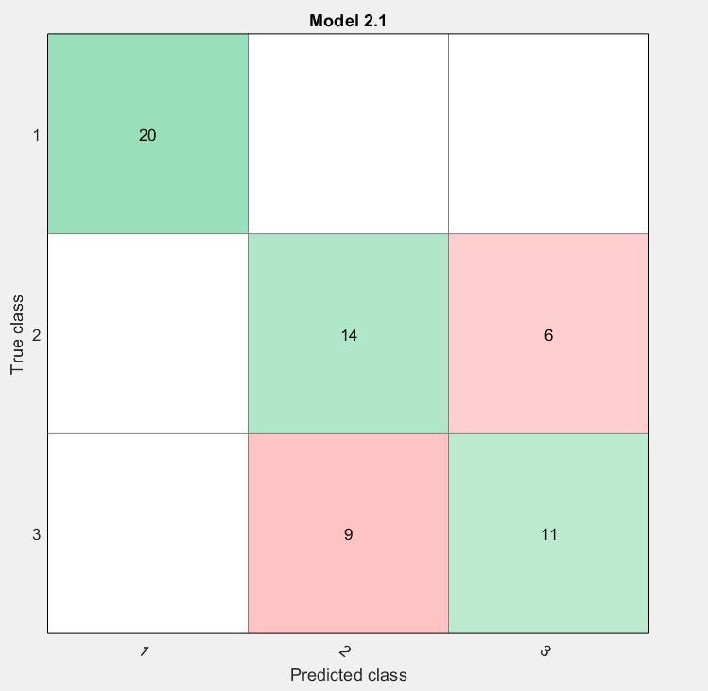
Mean Square Displacement
Linear Discriminant: 85% accuracy
Quadratic Discriminant: 85% accuracy
True class Types Clarified:
1=confinded
2=free
3=drift

Slide 8


Isotropy Analysis
Features:
Mean of R
Standard Deviation of R

Slide 9
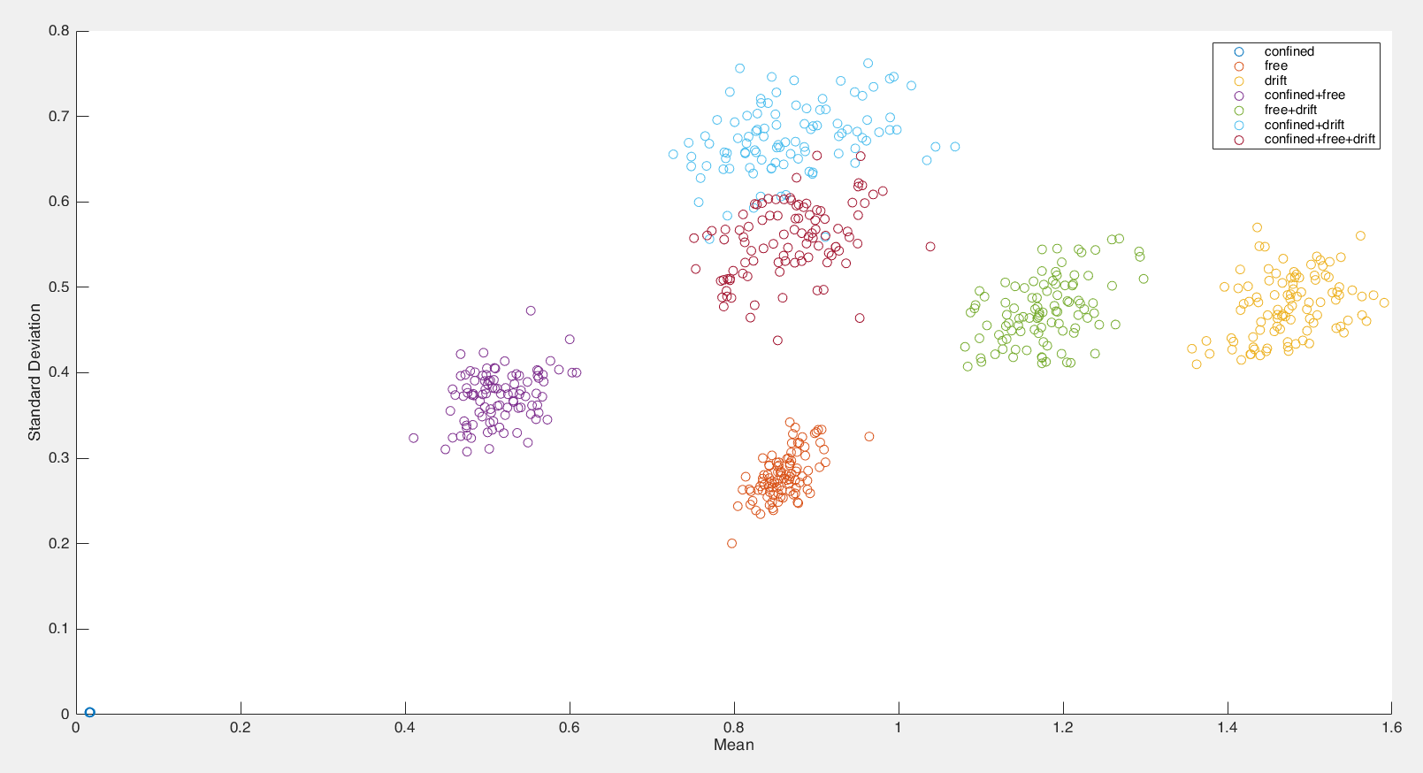
Isotropy Analysis (Cont.)

Slide 10
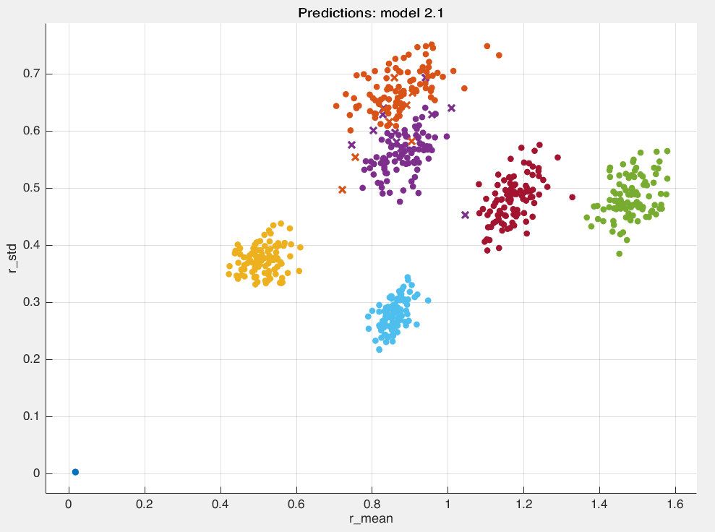
Isotropy Analysis (Clustering)

Slide 11
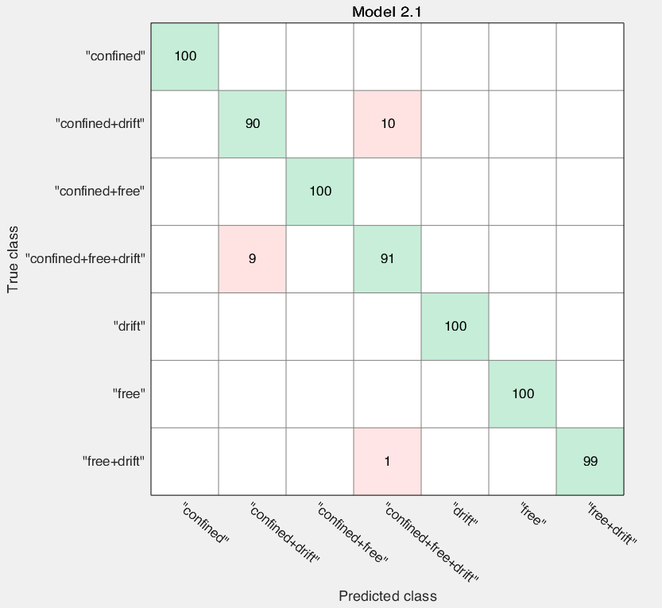
Isotropy Analysis (Confusion Matrix)
SVM: 98.1% Accuracy
KNN: 98.1% Accuracy

Slide 12
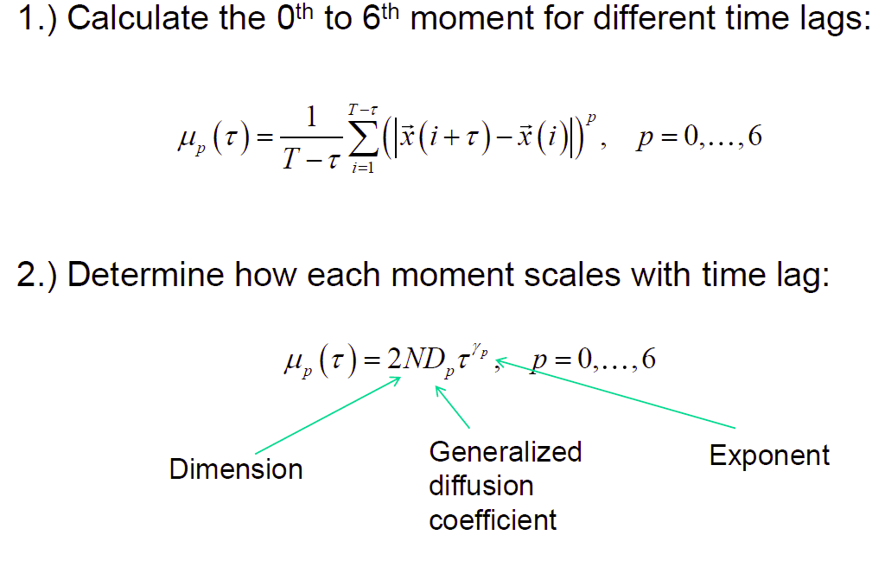
MOMENT SCALING DISPLACEMENT

Slide 13
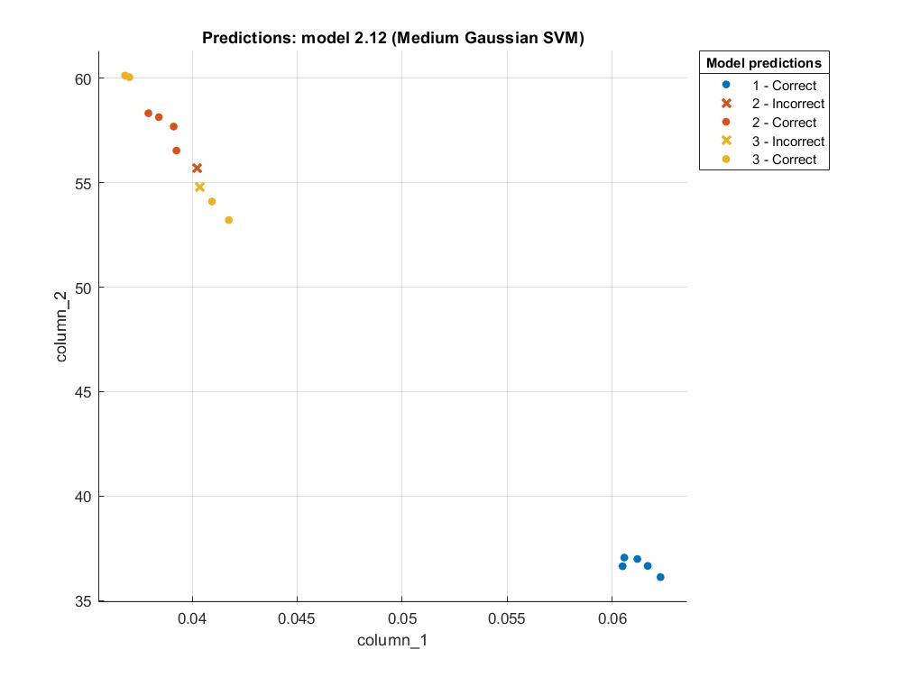
MOMENT SCALING DISPLACEMENT ( SVM)

Slide 14
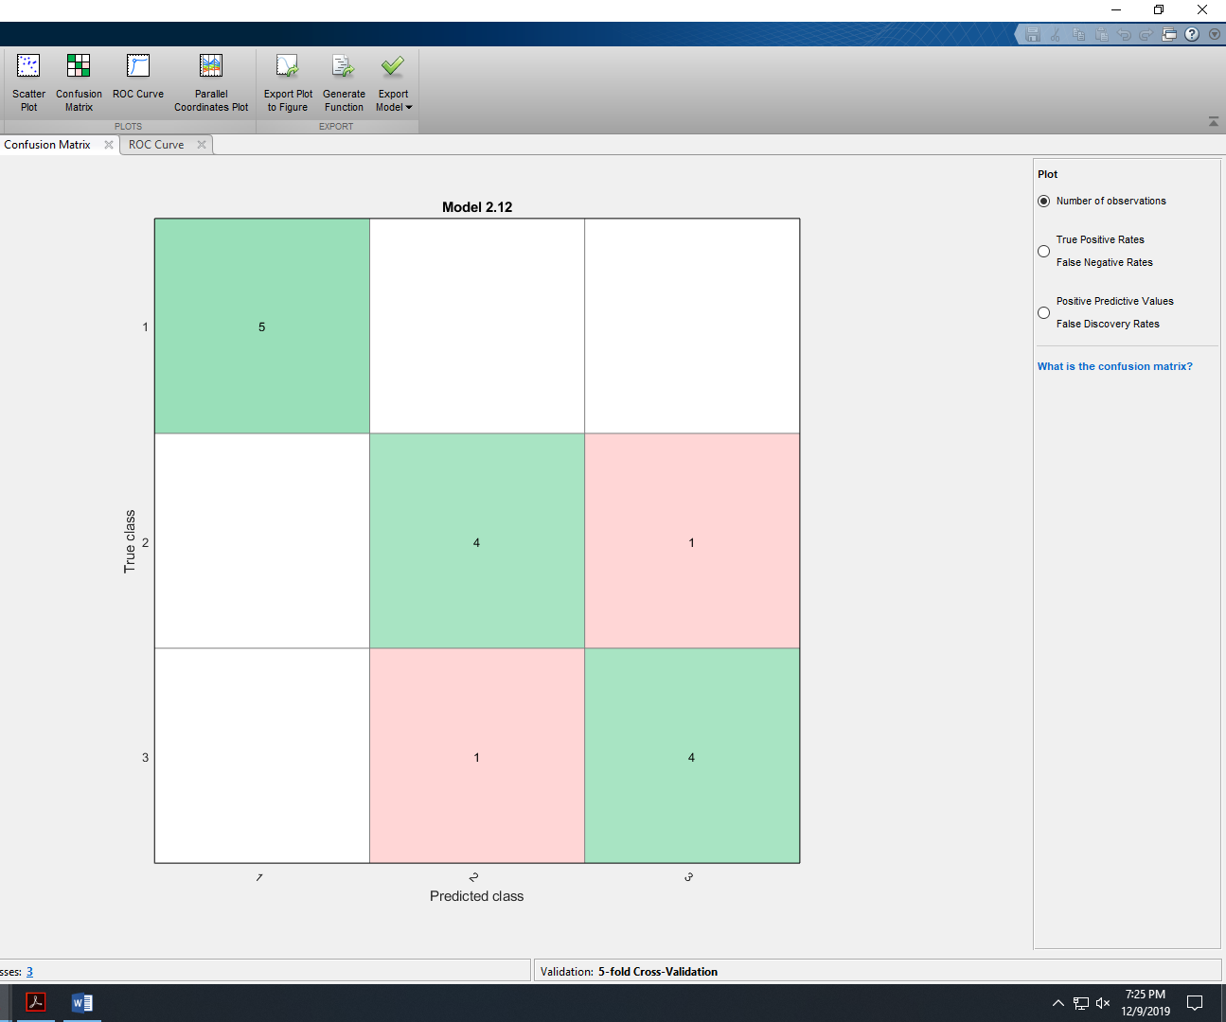
MOMENT SCALING DISPLACEMENT ( SVM)
SVM- 86.7% ACCURACY
Quadratic Discriminant: 86.7% ACCURACY

Slide 15
Cross Validation Motion Classifier
Mean Square Displacement: 36% accurate using challenge data
Ideally use isotropy analysis due to high training accuracy and ability to detect switching motion

Slide 16
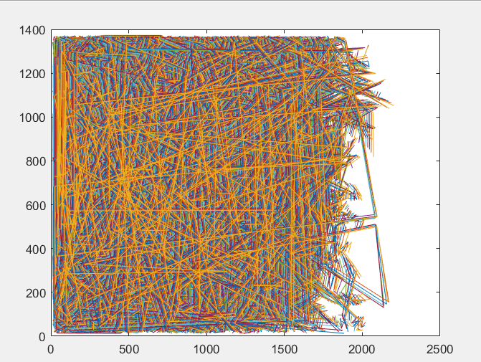
Classifying Real Trajectories
Cells Undergoing Sheet Migration
Using Mean Squared Displacement
Motion Classified as DRIFT
Limitation:
MSD cannot find switching motions
Drift vs free motion are difficult to distinguish against

